Slide 1
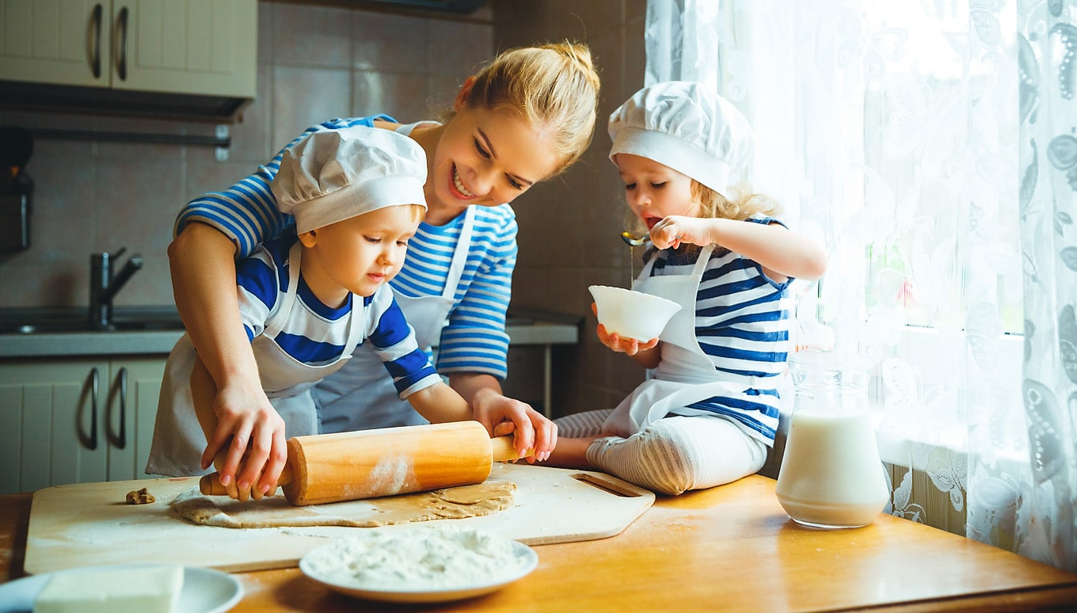
10 SORUDA ‘IN THE KITCHEN’

Slide 2
1
Imagine that one of your friends offers you to eat chocolate cake. You like it but you are not in the mood for now. You would like to eat something sour.
How do you say?
I’m sorry but I hate eating dessert.
Sure. I’m crazy about eating cake.
No, thanks. How about eating ice-cream with lemon?
That sounds good. Where are we eating?

Slide 3
1
Imagine that one of your friends offers you to eat chocolate cake. You like it but you are not in the mood for now. You would like to eat something sour.
How do you say?
I’m sorry but I hate eating dessert.
Sure. I’m crazy about eating cake.
No, thanks. How about eating ice-cream with lemon?
That sounds good. Where are we eating?

Slide 4
Adjectives about food/drinks
Sour
Spicy
Sweet
Milky
Salty
Bitter
Greasy
Tasty
ekşi
baharatlı
tatlı
sütlü
tuzlu
Karşımıza çıkabilecek kalıplar;
It’s not salty. Could you sprinkle
some salt, please?
It’s too greasy. I think it’s unhealthy.
I prefer eating sour food to sweet food.
acı
yağlı
lezzetli

Slide 5
2
Rose: I’m planning to eat chicken for dinner. How about frying it?
Tim: I’m not sure. It’s not healthy. ----.
Rose: OK, then. We can bake the chicken.
Tim: That’s better. Let me help you with the salad while you’re baking the chicken.
Which of the following completes the dialogue best?
I prefer eating baked or grilled chicken
Fried chicken is my favourite
I prefer eating fish to chicken
I hate eating chicken

Slide 6
2
Rose: I’m planning to eat chicken for dinner. How about frying it?
Tim: I’m not sure. It’s not healthy. ----.
Rose: OK, then. We can bake the chicken.
Tim: That’s better. Let me help you with the salad while you’re baking the chicken.
Which of the following completes the dialogue best?
I prefer eating baked or grilled chicken
Fried chicken is my favourite
I prefer eating fish to chicken
I hate eating chicken

Slide 7
Verbs related to cooking
Bake
Grill
Roast
Fry
Boil
Steam
Put
Add
Pour
Cut
Slice
Fırında pişirmek
peel
Dice
Chop
Stir
Mix
Whisk
Sprinkle
Knead
Melt
Grate
Spread
serve
Soymak
Küp küp doğramak
Izgarada pişirmek
doğramak
Fırında et kızartmak
karıştırmak
Yağda kızartmak
karıştırmak
haşlamak
Çırpmak, karıştırmak
Buharda pişirmek
serpmek
koymak
yoğurmak
eritmek
eklemek
rendelemek
dökmek
Yaymak
kesmek
Servis etmek
dilimlemek

Slide 8
Melt: eritmek melted: eritilmiş/erimiş
Chop: doğramak chopped: doğranmış
Grate: rendelemek grated rendelenmiş
Özellikle sıralama sorularında önemli bir noktadır!!
e.g.
Peel some potatoes.
Put the peeled potatoes into the frying pan.

Slide 9
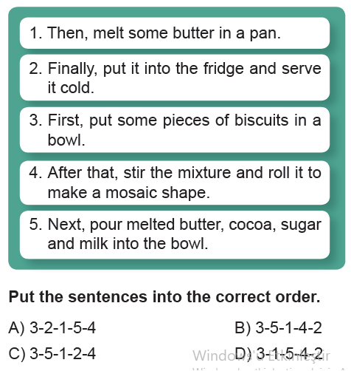
3

Slide 10
3

Slide 11
FIRST,
SECONDLY,
THEN,
NEXT,
AFTER THAT,
FINALLY
Tarife başlamadan önce bir giriş cümlesi
ya da tarifin sonunda son bir kapatma
cümlesi olabileceğini aklımızdan
çıkarmamalıyız!
e.g.
1- Today, I will tell you how to make omelette.
2- First, ………
3- …
4- …
5- Finally, cook for five minutes.
6- It’s ready. Enjoy your meal.

Slide 12
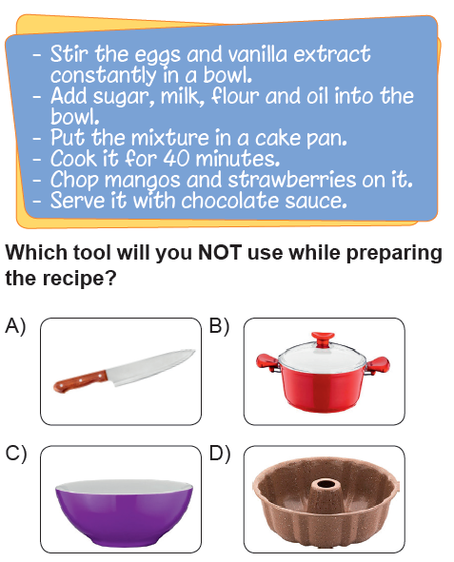
4
(More & More-Selfie Test 8)

Slide 13
4
(More & More-Selfie Test 8)

Slide 14
KITCHEN TOOLS
Knife
Frying pan
Saucepan
Bowl
Grater
Owen
Fork
Cake pan
Baking tray
Tablespoon
Teaspoon
Strainer
Roller pin
bıçak
tava
tencere
kase
rende
fırın
çatal
Kek kabı
Fırın tepsisi
Yemek kaşığı
çay kaşığı
süzgeç
oklava

Slide 15
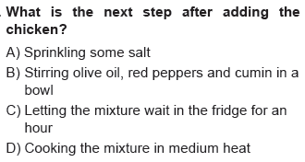
5

Slide 16
5

Slide 17
Before / After sorularında
before ve after kendilerinden sonra gelen cümleye anlam verir.
Before you pour the mixture, spread some butter into the pan.
Spread some butter into the pan before you pour the mixture.
Her iki şekilde de yazılır
First, spread some butter into the pan.
Then, pour the mixture.
Soruda, kolayca ayırmak için;
Before ve after ‘dan hemen önce cümleyi bölün.
Put the peeled vegetables into the saucepan before adding boiled water
(Tencereye soyulmuş sebzeleri koy)
(kaynamış su eklemeden önce)

Slide 18
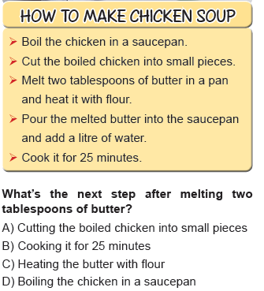
6

Slide 19
6

Slide 20
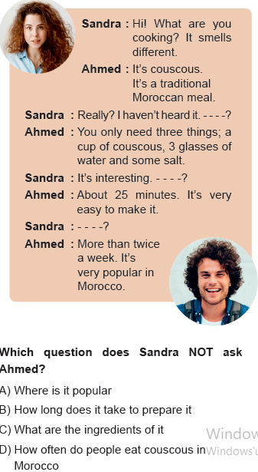
7
(More & More-Selfie Test 8)

Slide 21
7
(More & More-Selfie Test 8)

Slide 22
TRADITIONAL FOOD
Where is it popular?
Which country does it belong to?
Turkey Kebab
Italy Pizza
Japan Sushi
France Croissant
Morocco Couscous
The USA Hamburger

Slide 23
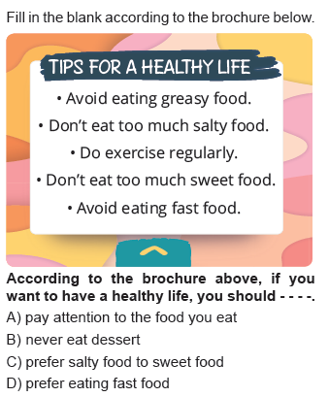
8
(More & More-Selfie Test 8)

Slide 24
8
(More & More-Selfie Test 8)

Slide 25
Good eating habits
Unhealthy food:
Greasy
Fast food
Junk food
Too much salt
Too much sweet
Fried food
…
Healthy food:
Vegetables
Fruit
Baked food
Steamed food
…

Slide 26
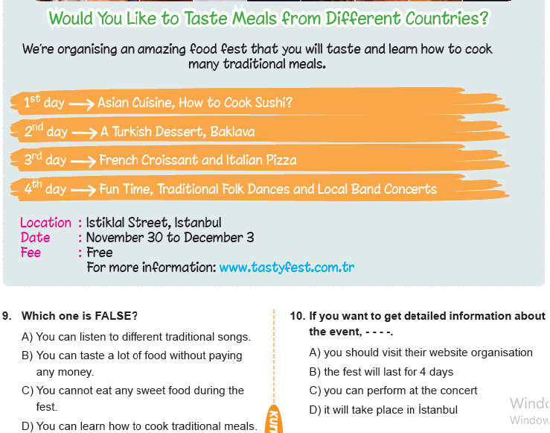

Slide 28
9 KASIM’DA TÜYAPTA,
ÇAYA BEKLERİM ☺
9 KASIM 2019
12:00 – 17:00
SALON: 6 STAND: 6105

Slide 29
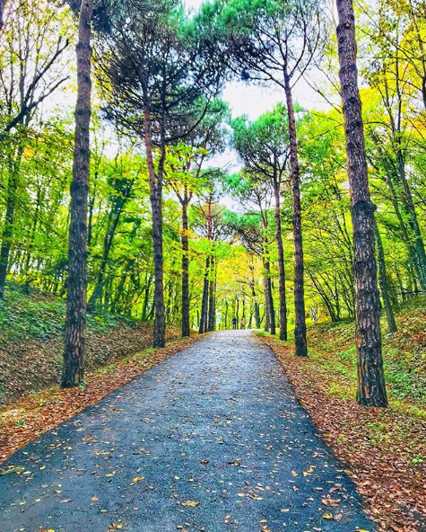
by Gökhan KARAKAYA

